Slide 1

Online auction system
2010030015-B.ANIL KUMAR
2010030020-B.SAI RISHAL
2010030288-L.DILEEP SAI

Slide 2
INTRODUCTION
Online auction is an electronic commerce (EC) technologyfor trading merchandise and services across a global emarketplace using web-services. This technology hasbecome an increasingly prevalent mechanism for bothsectors, consumers as well as amongst retailers, such asbusinesses and consumers (B2C)
These days with the development of informationtechnology, Internet auction has become more popular andhas been accepted by clientele. The popularity ofelectronic auction is a result of improved EC developmentthus gaining wide spread approval
The Internetprovides almost perfect market information andinfrastructure for executing auctions at loweradministrative costs

Slide 3
ABSTRACT
Objective behind this project is to provide an easy and effective way tobidders , Who are willing to turn their money into asset.
• Here they find each and everything which they are looking for . We kepteach and every aspects of bidders into our mind and try to fixeverything user friendly.
• The project has been designed to simulate the working of an actual Eauction site.

Slide 4
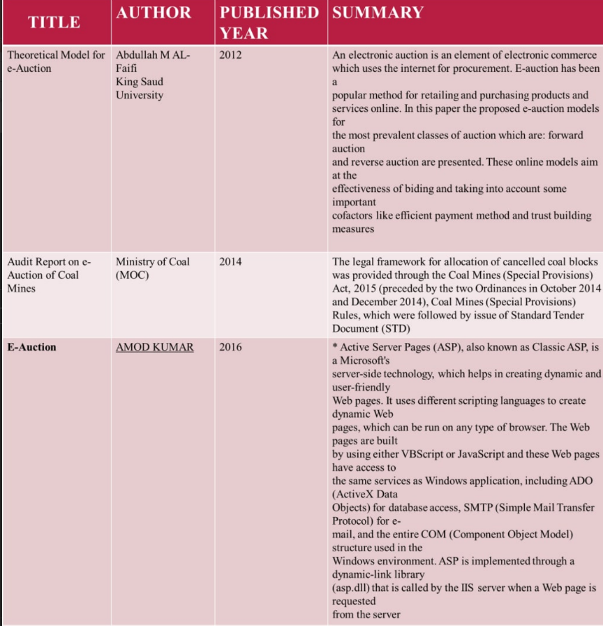
Literature Survey

Slide 5
DRAWBACKS OF TRADITIONAL AUCTION
1. It was time consuming and very hectic.
2. Bidders had to physical present there during the time ofbidding.
3. There were scopes of fixing and other illegal activities.
4. No assurance of good to be in proper condition
5. Con men were highly active

Slide 6

HOW ONLINE AUCTION IS THE ANSWER?
Provides a global platform for bidders by getting it to masses
Any interested party can put their goods for auction.
Large number of bidders
Large number of sellers
No need to be physically present there for the bidders
Transactions are safe as it safeguard both the parties

Slide 7
SOFTWARE REQUIREMENTS
Operating system : - Windows server 2010 or any compatible server OS
Framework : .Net framework 4.0
Web Server :- IIS 6.0
Front End: - ASP. NET with C# (.NET framework 4.0)
Back End : - SQL server 2010
Operating system : - Windows XP or any compatibleOS
Browser : - Anycompatible BROWSER

Slide 8

FUNCTIONALITY REQUIREMENTS
ADMIN
UPDATION: Admin has access to update products and category.
REGISTRATION: registering users having valid id.
DECLARING WINNER: user with highest bid should be allowed winner.
DELETION: Deleting products which has been sold out.
GUEST
VIEW: visitors can see the products.
REGISTER: can register if interested.
MEMBER
VIEW: Can view products.
BID: Bid for the products, in which they are interested.
LOGIN: Can login once registered.

Slide 9
REFERENCES
[1 Matthias Fuchs, Alexander Eybl, and Wolfram Höpken,“Successfully selling accommodation packages at onlineauctions the case of eBay”, Austria, Tourism Management,Vol. 32, No.5, (2011), 1166-1175.
[2] Michael Harkavy, J. D. Tygar, Hiroaki Kikuchi, “ElectronicAuctions with Private Bids”, Proceedings of the 3rdUSENIX Workshop on Electronic Commerce, Vol. 3.(1998).
[3] Jarrod Trevathan, Hossien Ghodosi, and Wayne Read,“ An Anonymous and Secure Continuous Double AuctionScheme”, Proceedings of the 39th Hawaii InternationalConference on System Sciences, (2006), 125b - 125b.
[4] Islam, N., and Rahman, M. Z.,“ Secure online sealed bidAuction”, Proceedings of 11th International Conference onComputer and Information Technology, (2008), 593 – 598.
[5] Wei Zhang,“ Computational Trust Model in OnlineAuctions”, International Conference on WirelessCommunications, Networking and Mobile Computing,(2007), 3767 – 3770.
[6] Dong-Her Shih, David C. Yen, Chih-Hung Cheng, andMing-Hung Shih,“ A secure multi-item e-auctionmechanism with bid privacy”, Computers & Security, Vol.30, No 4, (2011), 273-287.
[7] Chien Lung Hsu, Tzong-Sun Wu, and Han-YuLin,“ Password-Based Authenticated Key ExchangeProtocol without Trusted Third Party for Multi-ServerEnvironments”, International Journal of InnovativeComputing, Information and Control, Vol. 8, No.3, (2012),1541-1555.

Slide 10
conclusion
In this effort, the proposed models for the most famous types of electronic auction which are forward auction and reverse auction are presented. In these models we took into account the dependency issue that can arise during the eauction transactions. It must be solved by the trust issue within the registration phase where each seller or buyer should register in the auction using ID to be authentication to access the auction and allowed for authorization/operations. Further, the proposed models also consider the payment procedure and communicate through the auction model with the bank system to allow to the auction's winner to deposit his amount easily, and also enables the auctioneer to check the payment statues before delivering the goods. Furthermore, these models are protecting the e-auction from the malicious sellers and bidders by using a high level of trust and security at different levels of communications.

Slide 11
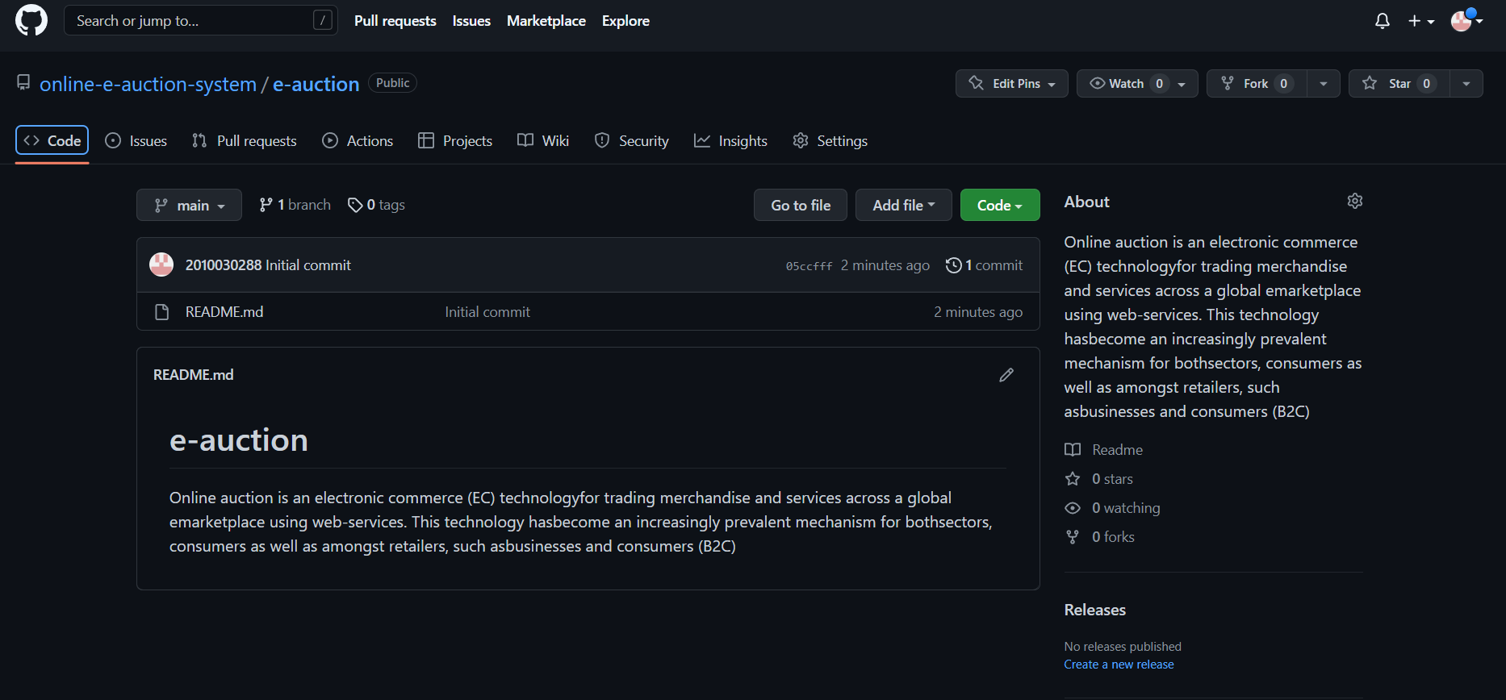

Slide 12

THANKYOU

